Slide 1
The Fundamental of Mobile Robot
Machine Perception and Interaction Group (MPIG)
http://www.mpig.com.cn
szl@mpig.com.cn

Slide 2



All the codes and slides accompanying the course are open-source
https://github.com/sunzuolei/robot
https://git.oschina.net/samuel/rob

Slide 3
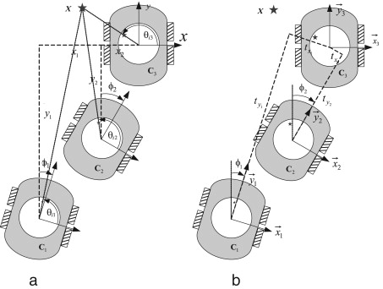
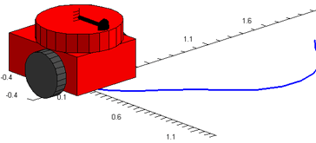
Geometry in Robotics

Slide 4
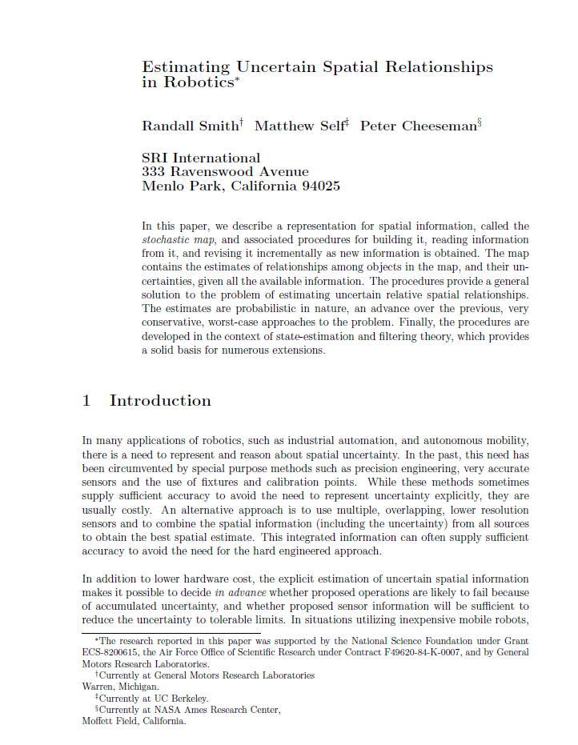
@article{
author = {Smith, R. and Self, M. and Cheeseman, P.},
title = {Estimating uncertain spatial relationships in robotics},
journal = {Autonomous Robot Vehicles},
pages = {167-193},
year = {1990}
}

Slide 5
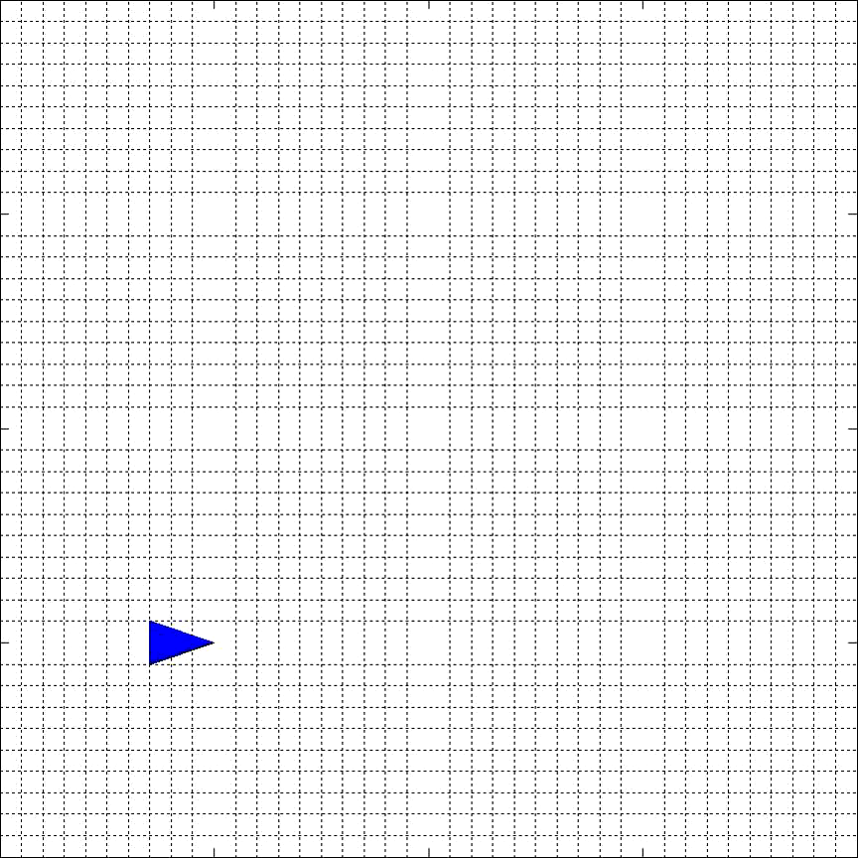

Slide 6
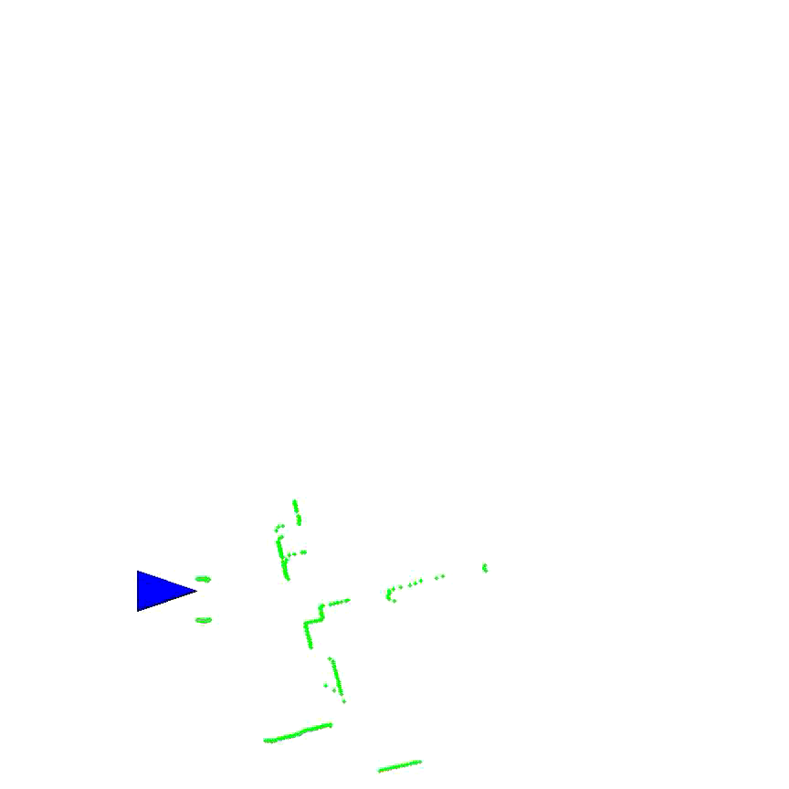

Slide 7
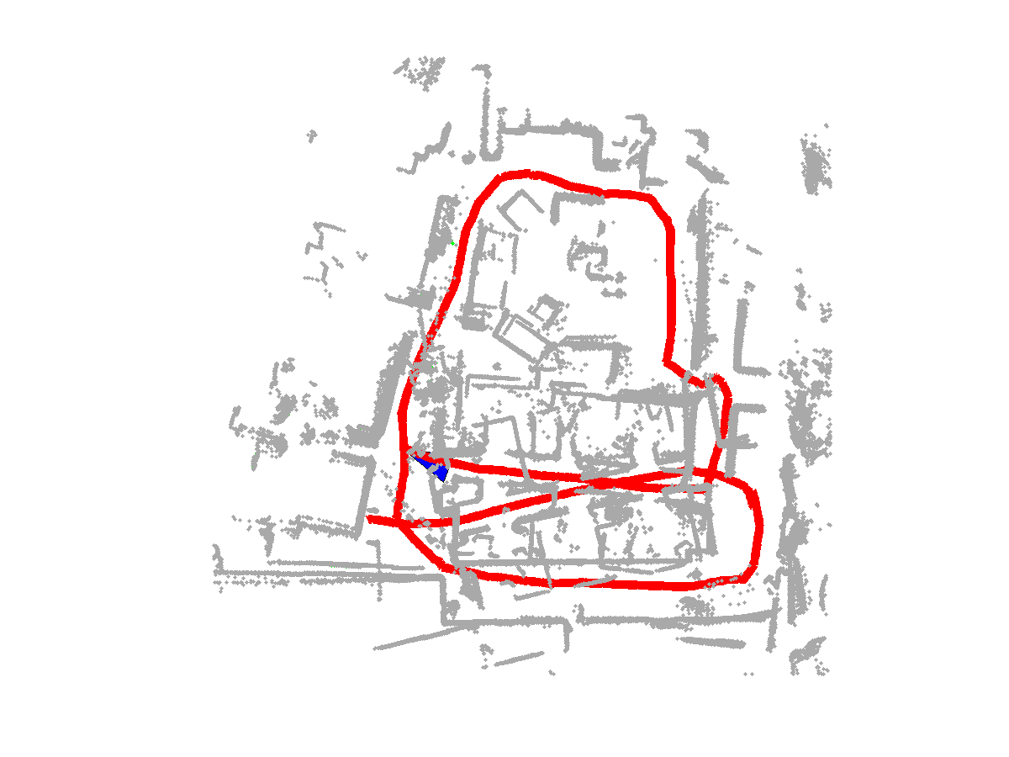
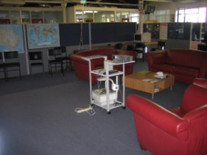
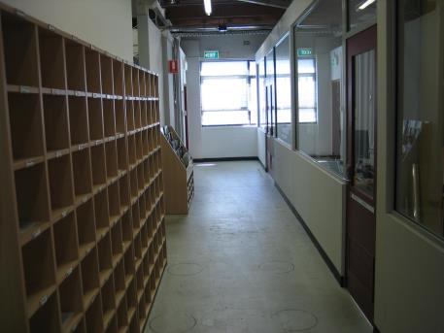
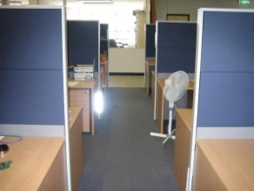
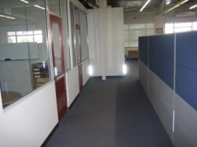

Slide 8

What are the essential issues behind the demos?

Slide 9
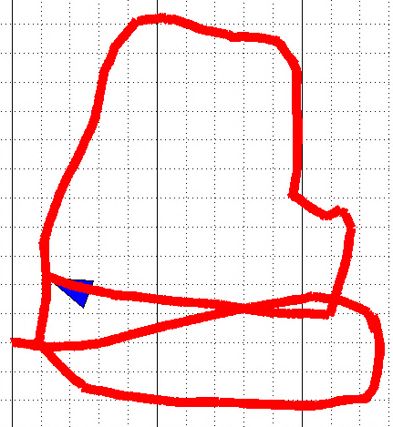
Coordinate frames
Spatial relationships
Transformation

Slide 10
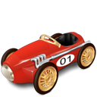
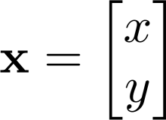

Suppose the robot starts from [A, B], then it moves C along x and D along y, where is the robot now?

Slide 11
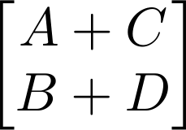
We can locate the robot at
Let us calculate it more elegantly.

Slide 12
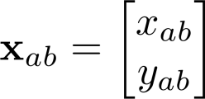
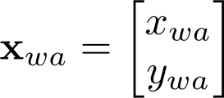


Slide 13


Slide 14
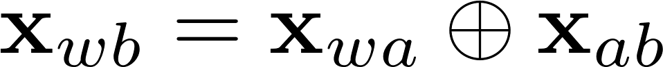


head-to-tail
Compounding

Slide 15



Compounding

Slide 16

Compounding

Slide 17
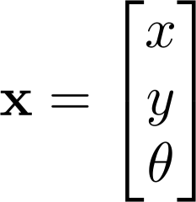
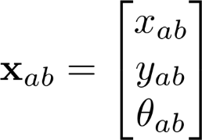
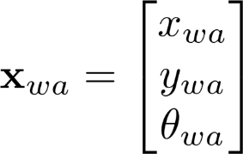

Slide 18
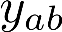
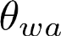
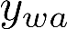
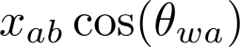

Slide 20
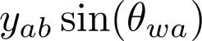

Slide 21
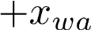

Slide 22


Slide 23
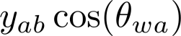

Slide 27
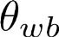
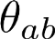
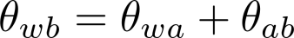

Slide 28
head-to-tail
Compounding

Slide 29
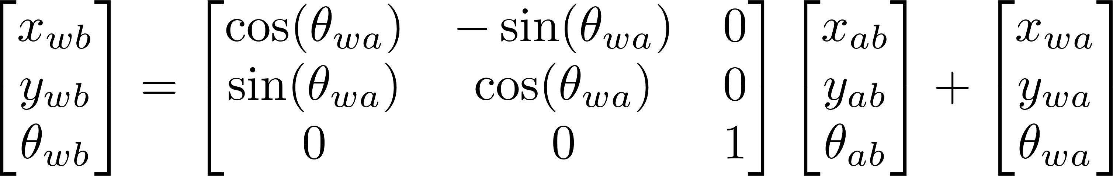
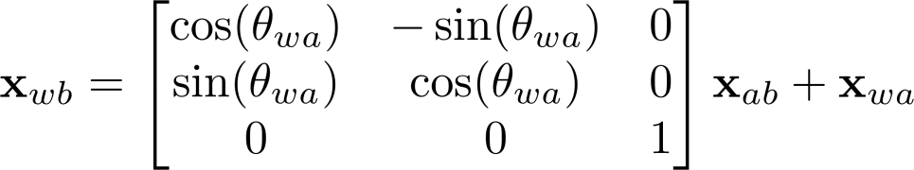

Slide 30
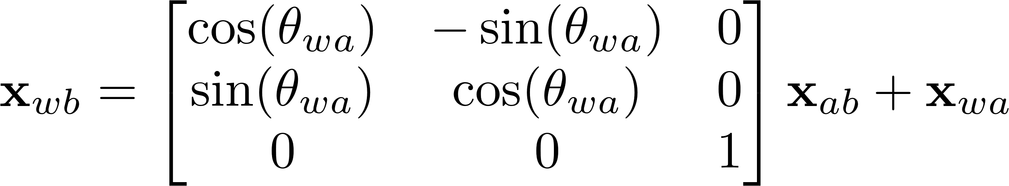
Transformation matrix
Translation
Rotation
http://en.wikipedia.org/wiki/Transformation_matrix

Slide 31
Robot-centered frame
Sensor-centered frame
Robot-centered frame
Sensor-centered frame
World frame

Slide 32
The coordinate of pose a is (5m, 3m, 50degree) ;
The pose b locates at
(4m, 2m, 20degree)
with respect to the robot-centered frame of pose a.
What is the coord. of pose b w.r.t world frame?

Slide 33
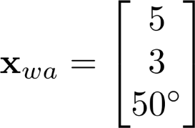

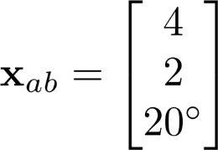
The coordinate of pose a is (5m, 3m, 50degree) ;
The pose b locates at
(4m, 2m, 20degree)
with respect to the robot-centered frame of pose a.
What is the coord. of pose b w.r.t world frame?

Slide 34
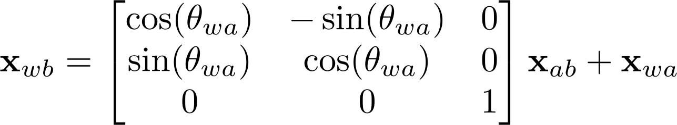
Let’s implement this!
head-to-tail
Compounding

Slide 35
P22
Xwa = [5; 3; degtorad(50)];
Xab = [4; 2; degtorad(20)];
Xwb = compound(Xwa, Xab);
fprintf('Xwb is (%.2fm, %.2fm, %.2fdegree)\n',...
Xwb(1), Xwb(2), radtodeg(Xwb(3)));

Slide 36
P22
function Xwb = compound(Xwa, Xab)
rot = [cos(Xwa(3)) -sin(Xwa(3));
sin(Xwa(3)) cos(Xwa(3))];
Xwb(1:2,:) = rot * Xab(1:2,:) +
repmat(Xwa(1:2), 1, size(Xab,2));
%% if Xwb is a pose and not a point
if size(Xab,1) == 3
Xwb(3,:) = piTopi(Xwa(3,:) + Xab(3));
end
end
Xab can be of size 3*n or 2*n

Slide 37
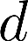
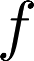
The coordinate of pose a is (5m, 3m, 50degree) ;
Two features are sensed. Their coordinates in robot-centered frame are
(3m, 2.5m), (5m, 2m).
What are the coords. of feature f and d w.r.t world frame?

Slide 38
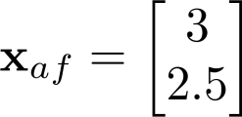
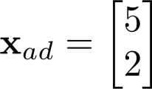
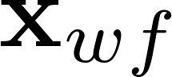

The coordinate of pose a is (5m, 3m, 50degree) ;
Two features are sensed. Their coordinates in robot-centered frame are
(3m, 2.5m), (5m, 2m).
What are the coords. of feature f and d w.r.t world frame?

Slide 39

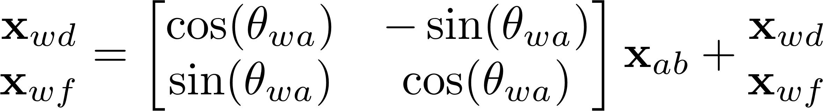
Let’s implement this!
head-to-tail
Compounding

Slide 40
P23
Xwa = [5; 3; degtorad(50)];
Xad = [5; 2];
Xaf = [3; 2.5];
Xadf = [Xad, Xaf];
Xwd = compound(Xwa, Xad);
Xwf = compound(Xwa, Xaf);
Xwdf = compound(Xwa, Xadf);
%%
disp('Xwd = ');
disp(Xwd);
disp('Xwf = ');
disp(Xwf);
disp('Xwdf = ');
disp(Xwdf);

Slide 41
The coordinate of pose a is (5m, 3m, 50degree) ;
The pose b locates at
(4m, 2m, 20degree)
with respect to the robot-centered frame of pose a.
Let’s implement this!
How can we visualize the robot body shape?

Slide 42
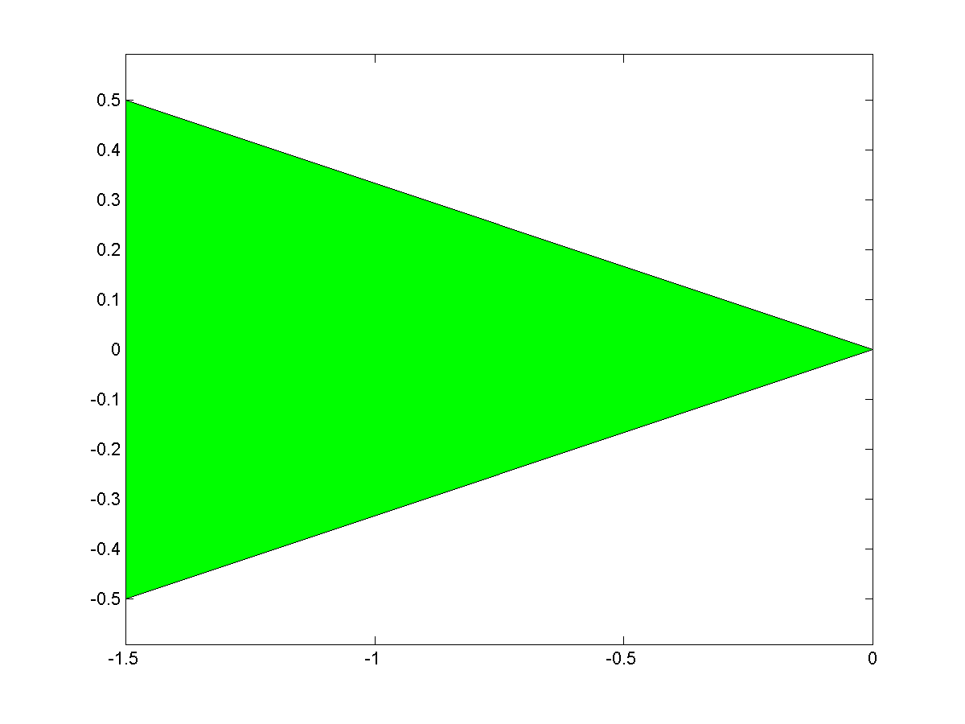
P24

Slide 43
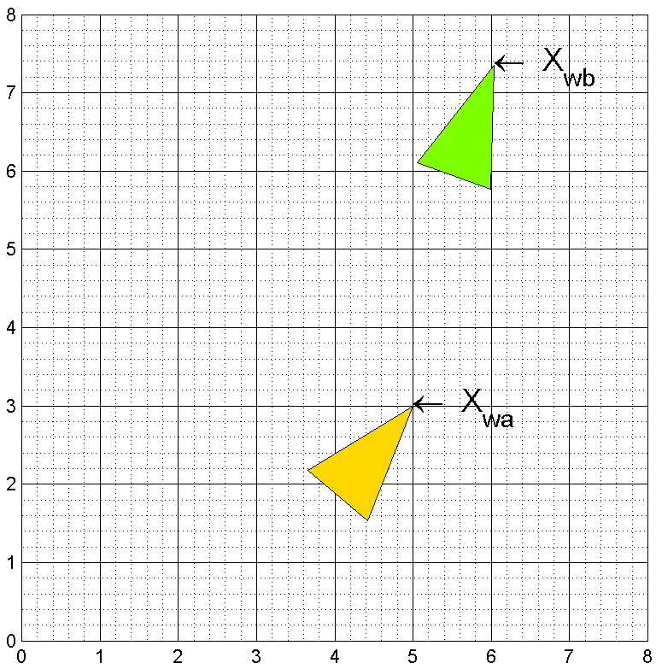
P24

Slide 44
rob = [0 -3 -3;
0 -1 1] * 0.5;
%%
figure('name', 'Robot appearance')
patch(rob(1, :), rob(2, :), 'g');
axis equal;
box on;
print('-dpng', 'robotbody.png');
%%
Xwa = [5; 3; degtorad(50)];
Xab = [4; 2; degtorad(20)];
Xwb = compound(Xwa, Xab);
%%
robA = compound(Xwa, rob);
robB = compound(Xwb, rob);
P24

Slide 45
figure('name', 'Visualization of robot body')
hold on;
axis equal;
grid minor;
xlim([0, 8]);
ylim([0, 8]);
pRobA = patch(robA(1, :), robA(2, :), [255,215,0]/255);
text(Xwa(1), Xwa(2), '\leftarrow X_{wa}', 'FontSize', 18);
pRobB = patch(robB(1, :), robB(2, :), [127,255,0]/255);
text(Xwb(1), Xwb(2), '\leftarrow X_{wb}', 'FontSize', 18);
P24
RGB Color Table
http://www.wahart.com.hk/rgb.htm
http://gucky.uni-muenster.de/cgi-bin/rgbtab-en

Slide 46
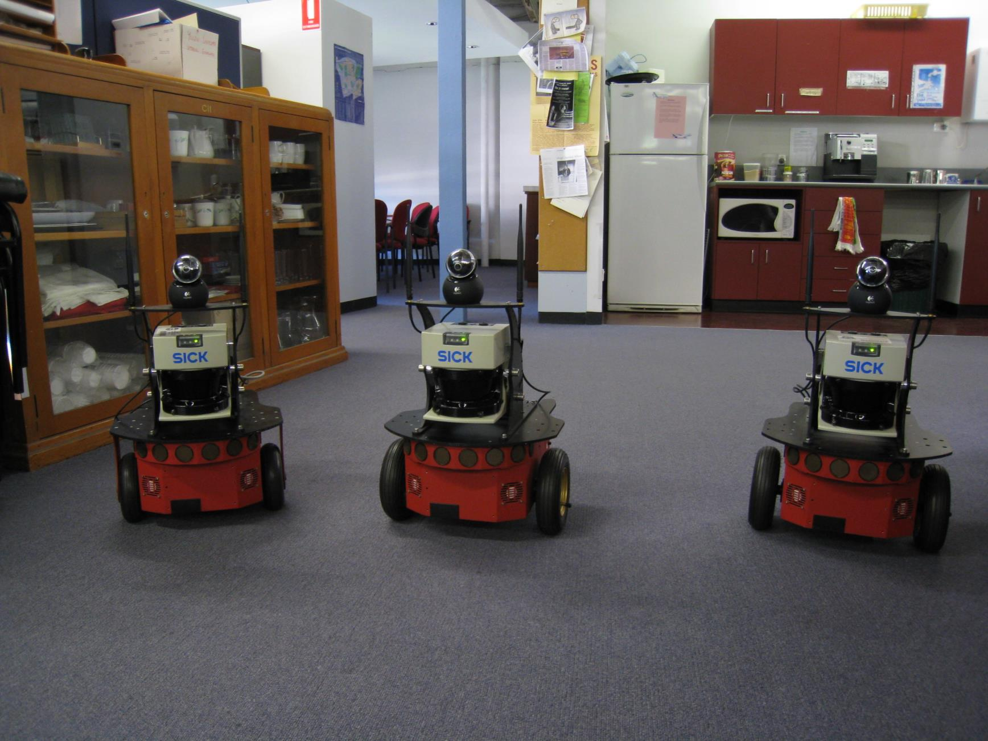
Play with real data

Slide 47
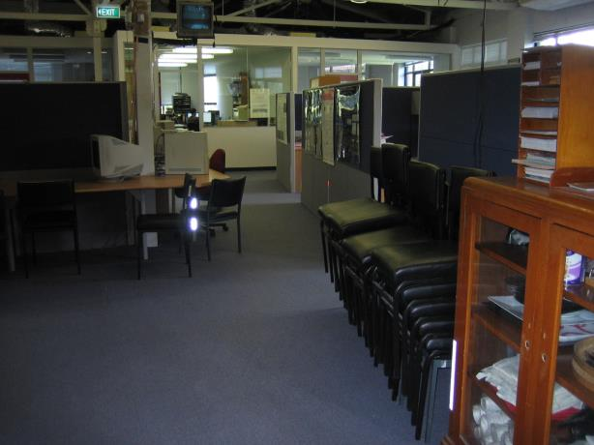
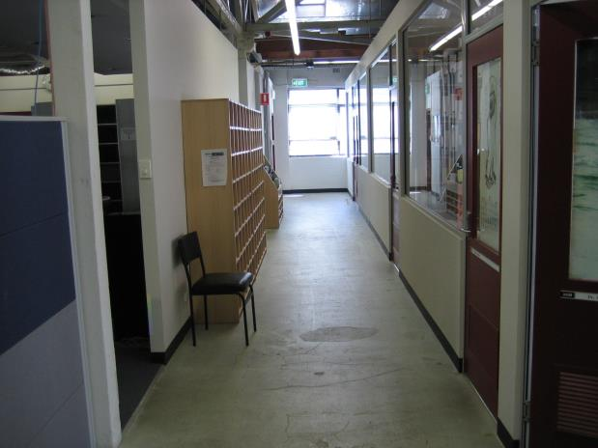
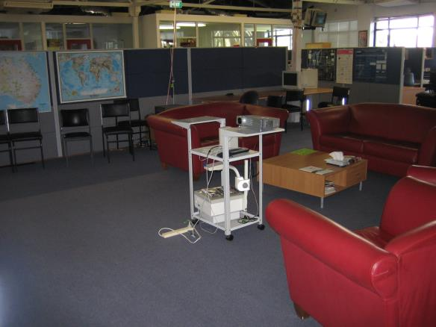
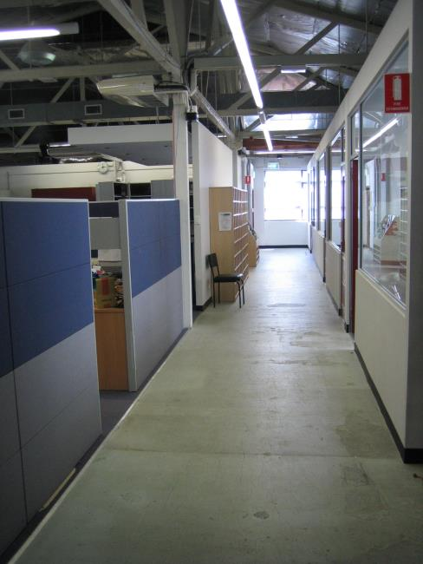
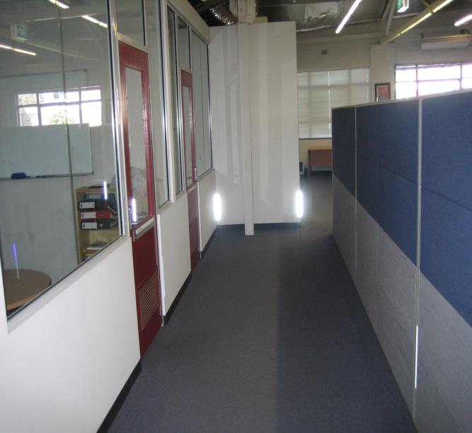


Slide 48
rose.mat
laser
2610 * 361
Laser point clouds
relMotion
3 * 2609
Relative motion
Translation and rotation

Slide 49
Calculate the robot poses with rotation and translations
Let’s implement this!

Slide 50

P25

Slide 51
P25
load '../data/rose.mat'
clear laser;
len = size(relMotion, 2);
rob = [0 -3 -3; 0 -1 1] * 0.5;
%% Initialize figure
figPos = get(0, 'ScreenSize'); % [left, bottom, width, height]
figPos(3) = figPos(3) - 100;
figure('name', 'Motion animation',...
'position', figPos,...
'color', 'w', 'Menu', 'none');
hold on; box on;
grid minor;
robPlot = patch(0, 0, 'b', 'erasemode', 'normal');
pathPlot = plot (0, 0, 'r-', 'linewidth', 5, 'erasemode','background');
xlabel('X(m)');
ylabel('Y(m)');
axis equal;
axis([-5 15 -5 15]);

Slide 52
P25
pos = zeros(3, 1);
path = zeros(3, len + 1);
for i = 1 : len
pos = compound(pos, relMotion(:, i));
path(:, i+1) = pos;
robPos = compound(pos, rob);
set(robPlot, 'xdata', robPos(1, :), 'ydata', robPos(2, :));
set(pathPlot, 'xdata', path(1, 1:i), 'ydata', path(2, 1:i));
drawnow;
pause(0.005);
end

Slide 53
Make video with Matlab
NOTE: The p26 employs the object VideoWriter and is debugged on Matlab 2013a, it might be not compatible with the version before 2011b.
P26
Let’s implement this!

Slide 54
%% Initialize vedio maker
videoObj = VideoWriter('robot.avi');
videoObj.FrameRate = 5;
videoObj.Quality = 100;
open(videoObj);
if mod(i, 6) == 0
frame = getframe;
writeVideo(videoObj, frame);
End
close(videoObj);
P26

Slide 55
Cartesian VS. Polar
http://en.wikipedia.org/wiki/Cartesian_coordinate_system
http://en.wikipedia.org/wiki/Polar_coordinate_system

Slide 56



Cartesian coordinate system
a coordinate system that specifies each point uniquely in a plane by a pair of numerical coordinates, which are the signed distances from the point to two fixed perpendicular directed lines, measured in the same unit of length.
Each reference line is called a coordinate axis or just axis of the system.
the point where they meet is its origin, usually at ordered pair (0, 0).

Slide 57



Polar coordinate system
In which each point on a plane is determined by a distance from a fixed point and an angle from a fixed direction.
The fixed point (analogous to the origin of a Cartesian system) is called the pole, and the ray from the pole in the fixed direction is the polar axis. The distance from the pole is called the radial coordinate or radius, and the angle is the angular coordinate, polar angle, or azimuth.

Slide 58

The coordinate of pose a is (5m, 3m, 50degree) ; The pose b’s displacement and rotation are 7m and 40degree w.r.t pose a’s robot-centered frame.
What is the coords. of b w.r.t world frame?

Slide 59
The coordinate of pose a is (5m, 3m, 50degree) ; The pose b’s displacement and rotation are 7m and 40degree w.r.t pose a’s robot-centered frame.
Range
Bearing
What is the coords. of b w.r.t world frame?

Slide 60
Transform Polar to Cartesian
Compound Xwa and Xab
Let’s implement this!

Slide 61
path(path, genpath('../p22'));
Xwa = [5; 3; degtorad(50)];
disB = 7;
rotB = degtorad(40);
[xab, yab] = pol2cart(rotB, disB);
Xab = [xab; yab; rotB];
Xwb = compound(Xwa, Xab);
fprintf('Xwb is (%.2fm, %.2fm, %.2fdegree)\n',...
Xwb(1), Xwb(2), radtodeg(Xwb(3)));
P27

Slide 62


Dead reckoning
head-to-tail
Compounding
http://en.wikipedia.org/wiki/Dead_reckoning
Displacement
Displacement
Displacement
Rotation
Rotation
Rotation

Slide 63
Odometry
head-to-tail
Compounding
Displacement
Displacement
Displacement
Rotation
Rotation
Rotation

Slide 64

Odometry
head-to-tail
Compounding
Encoder

Slide 65


Slide 66


Slide 67
Visual Odometry

Slide 68



Slide 69

A
B

Slide 70




+
=

Slide 71




1. Pixels selection
2. Stereovision
4. Motion
estimation
3. Pixels tracking
Stereovision

Slide 72

仅基于视觉……

Slide 73


Slide 74


Slide 75



Laser point clouds transformation

Slide 76


Slide 78


Slide 80
Transform Polar to Cartesian
Compound Xwa and Xaf

Slide 81
rose.mat
laser
2610 * 361
Laser point clouds
relMotion
3 * 2609
Relative motion
Translation and rotation

Slide 82

load '../data/rose.mat'
Let’s visualize the data!

Slide 83


P28

Slide 84
for i = 1 : len
points = getLaserPoint(laser(i, :), maxR);
set(lsrFig, 'xdata', points(1,:), ...
'ydata', points(2, :));
title(sprintf('Laser image Frame %d', i));
drawnow;
if mod(i, 4) == 0 && vedio
frame = getframe;
writeVideo(videoObj, frame);
end
if vedio == 0
pause(0.02);
end
end
P28

Slide 85
Combine the mapping and localization
P29

Slide 86
for i = 1 : len
pos = compound(pos, relMotion(:, i));
path(:, i+1) = pos;
robPos = compound(pos, rob);
points = getLaserPoint(laser(i+1, :), maxR);
pointsWorld = compound(pos, points);
set(robPlot, 'xdata', robPos(1, :), 'ydata', robPos(2, :));
set(pathPlot, 'xdata', path(1, 1:i), 'ydata', path(2, 1:i));
set(lsrPlot, 'xdata', pointsWorld(1, :), ...
'ydata', pointsWorld(2, :));
plot(pointsWorld(1, 1: n : end), pointsWorld(2, 1: n : end),...
'.', 'markersize', 3, 'color', [169,169,169] / 255);
drawnow;
if mod(i, 6) == 0 && vedio
frame = getframe;
writeVideo(videoObj, frame);
end
end
P29

Slide 87
Inversion

Slide 88
The coordinate of pose b is (5m, 3m, 50degree) w.r.t pose a’s robot-centered frame.
What is the coords. of a w.r.t the robot-centered frame of b?

Slide 89



Slide 90
Transformation matrix
Translation
Rotation
http://en.wikipedia.org/wiki/Transformation_matrix

Slide 91





Slide 92

Compounding
Inversion
Section 3.2.2
[Smith 1990]
Let’s prove it by programming!

Slide 93
syms t x y t;
X = [x; y; t];
negX = -X;
R = [ cos(negX(3)), -sin(negX(3)), 0;
sin(negX(3)), cos(negX(3)), 0;
0, 0, 1];
invR = [ -cos(X(3)), -sin(X(3)), 0;
sin(X(3)), -cos(X(3)), 0;
0, 0, -1];
r1 = R * negX;
r2 = invR * X;
r3 = r1 - r2;
%%
disp('R * (-X) is:');
disp(r1);
disp('inv(R) * X is:');
disp(r2);
P30

Slide 94

Inversion
Section 3.2.2
[Smith 1990]
Let’s prove it by programming!

Slide 95
Xab = [96; 35; degtorad(62)];
Xba = inverse(Xab);
Xab_ = inverse(Xba);
Xab_(3) = radtodeg(Xab_(3));
disp(Xab_);
function Xba = inverse(Xab)
if size(Xab, 1) ~= 3 || size(Xab, 2) ~= 1
error('Xab should be of the size 3*1');
end
R = [ -cos(Xab(3)), -sin(Xab(3)), 0;
sin(Xab(3)), -cos(Xab(3)), 0;
0, 0, -1];
Xba = R * Xab;
Xba(3) = piTopi(Xba(3));
end
P31

Slide 96
Let’s implement this!

Slide 97
path(path, genpath('../p31'));
Xab = [5; 3; degtorad(50)];
Xba = inverse(Xab);
disp('Xba = ')
disp(Xba);
P32

Slide 98
Composite relationships

Slide 99
The coordinate of pose b is (5m, 3m, 50degree) w.r.t pose a’s robot-centered frame. The world coordinate of pose b is (9m, 6m, 70degree).
What is the coords. of a w.r.t the world frame?

Slide 100



Slide 101


Is this the unique solution?

Slide 102



Let’s prove it by programming!

Slide 103
path(path, genpath('../p31'));
path(path, genpath('../p22'));
%%
Xab = [5; 3; degtorad(50)];
Xwb = [9; 6; degtorad(70)];
%% First solution
Xba = inverse(Xab);
Xwa = compound(Xwb, Xba);
disp('Fisrt solution: ')
disp(Xwa);
%% Second solution
Xwa2 = inverse(compound(Xab, inverse(Xwb)));
disp('Second solution: ')
disp(Xwa2);
P33

Slide 104
Bicycle motion model
Courtesy of 许亚芳

Slide 105
Path dynamics
The vehicle performs a continuous movement. To analyze its movement, the derivations are required.
Translation
Rotation
angular derivation (angular velocity)
displacement derivation
(velocity)

Slide 106







Reference point
Front wheel
Wheel-base
Rear wheel
simplification

Slide 107

4-wheel
equivalent
2-wheel

Slide 108



Path dynamics

Slide 109


Path dynamics
How to compute Angular Velocity?

Slide 110


Circular motion
r

Slide 111


Angular velocity

Slide 112



discrete-time vehicle motion

Slide 113

Motion Model

Slide 114




velocity
steering

Slide 115

velocity
steering

Slide 116

Generate path
Based on the way points

Slide 117





Now we consider the waypoint without direction!

Slide 118
This angle must be kept within a certain range to keep balance !
If the vehicle wants to go to the next point, it must turn 50 degree to get there. Obviously, it has exceed its max degree (we assume the max degree is 20 degree)
How to deal with this situation ?

Slide 119



5
2
2
2
2
1

Slide 120
Turn steering
Y
N
Steering < maxG ?
Turn maxG
Go on

Slide 121
Summary
Compute steering
Rate control
Angular control
Let’s learn how to implement it !

Slide 122

P34

Slide 123
P34
Close all;clear all;clc;
Path(path, genpath(‘..\..\robotcourse));
load '../data/tim.mat'
clear lm;
steering=0;velocity=4.0;wheelbase=8;dt=0.05;iWp=1;iPos=1;
rob = [0 -wheelbase -wheelbase; 0 -4 4] ;
%% Initialize figure
figPos = get(0, 'ScreenSize');
figPos(3) = figPos(3) - 100;
figure('name', 'Motion animation',...
'position', figPos,...
'color', 'w', 'Menu', 'none');
hold on; box on;
grid minor;
robPlot = patch(0, 0, 'b', 'erasemode', 'normal');
pathPlot = plot (0, 0, 'r-', 'linewidth', 5, 'erasemode','background');
xlabel('X(m)');
ylabel('Y(m)');
axis equal;
axis([-110 100 -110 100]);

Slide 124
P34
pos = zeros(3, 1);
path = zeros(3, 3390);
%% Main loop
while iWp ~= 0
[steering,iWp]= compSteer(pos, wp, iWp, steering,dt);
pos(1) = pos(1) + velocity *dt *cos(steering +pos(3,:));
pos(2) = pos(2) + velocity *dt *cos(steering +pos(3,:));
pos(3) = pos(3) + velocity *dt *sin(steering)/wheelbase;
pos(3) = piTopi(pos(3));
robPos = compound(pos,rob);
path(:, iPos + 1)= pos;
iPos = iPos + 1;
%%
set(pathPlot,'xdata', path(1, 1:iPos),'ydata',
path(2,1:iPos));
set(robPlot,'xdata',robPos(1,:),'ydata',robPos(2,:));
drawnow;
end
Print(‘-dpng’,’path.png’)

Slide 125
P34
function [G,iwp]= compSteer(x,wp,iwp,G,dt)
maxG= 30*pi/180; rateG= 20*pi/180; minD = 0.5;
cwp= wp(:,iwp);
d2 = (cwp(1)-x(1))^2 + (cwp(2)-x(2))^2;
if d2 < minD^2
iwp = iwp+1; % switch to next
if iwp > size(wp,2) %reached final waypoint,return
iwp =0;return;
end
cwp= wp(:,iwp); % next waypoint
end
deltaG= piTopi(atan2(cwp(2)-x(2),cwp(1)-x(1))-x(3)-G);
% limit rate
maxDelta = rateG*dt;
if abs(deltaG) > maxDelta
deltaG = sign(deltaG)*maxDelta;
end
% limit angle
G= G+deltaG;
if abs(G) > maxG
G= sign(G)*maxG;
end
compSteer

